Slide 1
Chapter 13
Rapid software development

Slide 2
Objectives
To explain how an iterative, incremental development process leads to faster delivery of more useful software
To discuss the essence of agile development methods
To explain the principles and practices of extreme programming
To explain the roles of prototyping in the software process

Slide 3
Topics covered
Agile methods
Extreme programming
Rapid application development
Software prototyping

Slide 4
Software development history
No methodology. Personal craft, software crisis.
SE. From simple methodology to heavy-weight SE.
These heavy-weight ones is too over-specification and documentary, which leads to so-called new software crisis. 过犹不及
Today’s business leads to light-weight SE, called RAD.

Slide 5
Rapid software development
Because of rapidly changing business environments, businesses have to respond to new opportunities and competition.
This requires software and rapid development and delivery is often the most critical requirement for software systems.
Businesses may be willing to accept lower quality software if rapid delivery of essential functionality is possible.

Slide 6
Requirements
Because of the changing environment, it is often impossible to arrive at a stable, consistent set of system requirements.
Therefore a waterfall model of development is impractical and an approach to development based on iterative specification and delivery is the only way to deliver software quickly.

Slide 7
Characteristics of RAD processes
The processes of specification, design and implementation are concurrent. There is no detailed specification and design documentation is minimised.
The system is developed in a series of increments. End users evaluate each increment and make proposals for later increments.
System user interfaces are usually developed using an interactive development system.

Slide 8
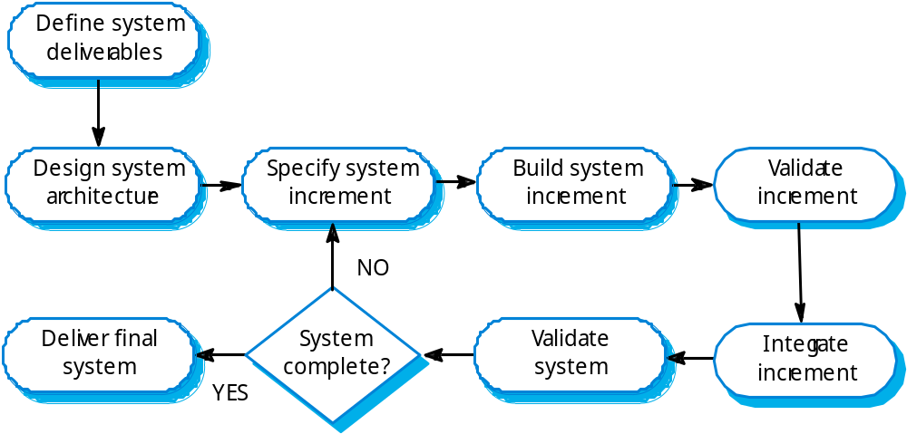
An iterative development process

Slide 9
Advantages of incremental development
Accelerated delivery of customer services. Each increment delivers the highest priority functionality to the customer.
User engagement with the system. Users have to be involved in the development which means the system is more likely to meet their requirements and the users are more committed to the system.

Slide 10
Problems with incremental development
Management problems
  Progress can be hard to judge and problems hard to find because there is no documentation to demonstrate what has been done.
Contractual problems
  The normal contract may include a specification; without a specification, different forms of contract have to be used.
Validation problems
  Without a specification, what is the system being tested against?
Maintenance problems
  Continual change tends to corrupt software structure making it more expensive to change and evolve to meet new requirements.

Slide 11
Prototyping
For some large systems, incremental iterative development and delivery may be impractical; this is especially true when multiple teams are working on different sites.
Prototyping, where an experimental system is developed as a basis for formulating the requirements may be used. This system is thrown away when the system specification has been agreed.

Slide 12
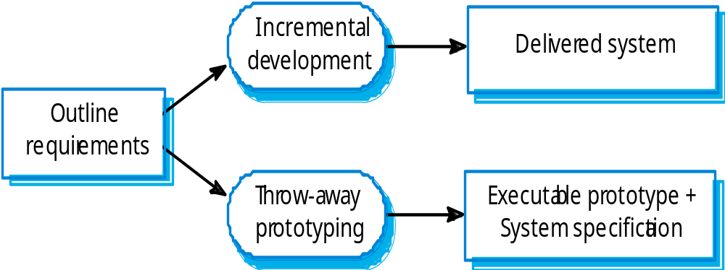
Incremental development and prototyping

Slide 13
Agile methods
Dissatisfaction with the overheads involved in design methods led to the creation of agile methods. These methods:
  Focus on the code rather than the design;
  Are based on an iterative approach to software development;
  Are intended to deliver working software quickly and evolve this quickly to meet changing requirements.
Agile methods are probably best suited to small/medium-sized business systems or PC products.

Slide 14
An Agile Process
Is driven by customer descriptions of what is required (scenarios)
Recognizes that plans are short-lived
Develops software iteratively with a heavy emphasis on construction activities
Delivers multiple ‘software increments’
Adapts as changes occur

Slide 15
Problems with agile methods
It can be difficult to keep the interest of customers who are involved in the process.
Team members may be unsuited to the intense involvement that characterises agile methods.
Prioritising changes can be difficult where there are multiple stakeholders.
Maintaining simplicity requires extra work.
Contracts may be a problem as with other approaches to iterative development.

Slide 16
Extreme programming
Perhaps the best-known and most widely used agile method.
Extreme Programming (XP) takes an ‘extreme’ approach to iterative development.
  New versions may be built several times per day;
  Increments are delivered to customers every 2 weeks;
  All tests must be run for every build and the build is only accepted if tests run successfully.

Slide 17
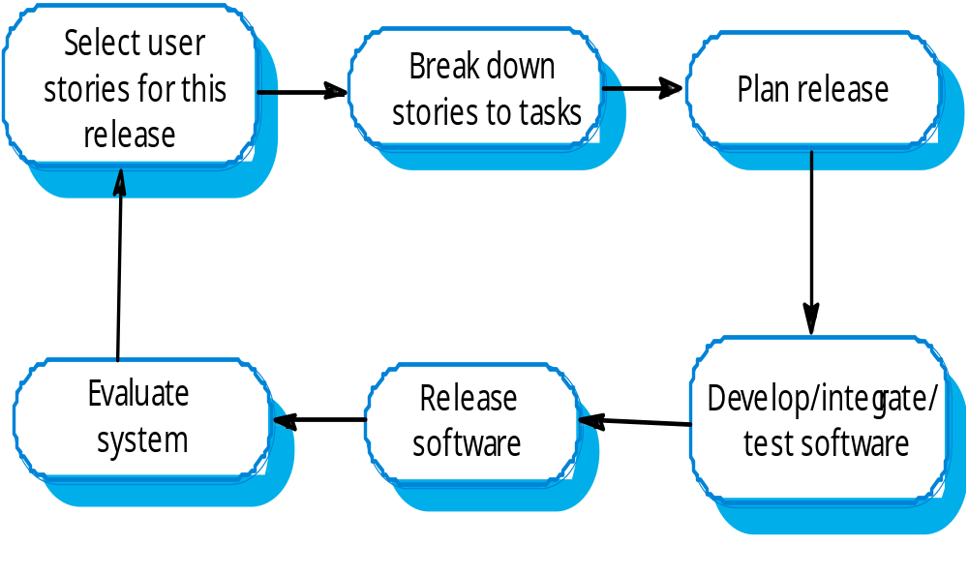
The XP release cycle

Slide 18
XP and agile principles
Incremental development is supported through small, frequent system releases.
Customer involvement means full-time customer engagement with the team.
People not process through pair programming, collective ownership and a process that avoids long working hours.
Change supported through regular system releases.
Maintaining simplicity through constant refactoring of code.

Slide 19
Requirements scenarios
In XP, user requirements are expressed as scenarios or user stories.
These are written on cards and the development team break them down into implementation tasks. These tasks are the basis of schedule and cost estimates.
The customer chooses the stories for inclusion in the next release based on their priorities and the schedule estimates.

Slide 20
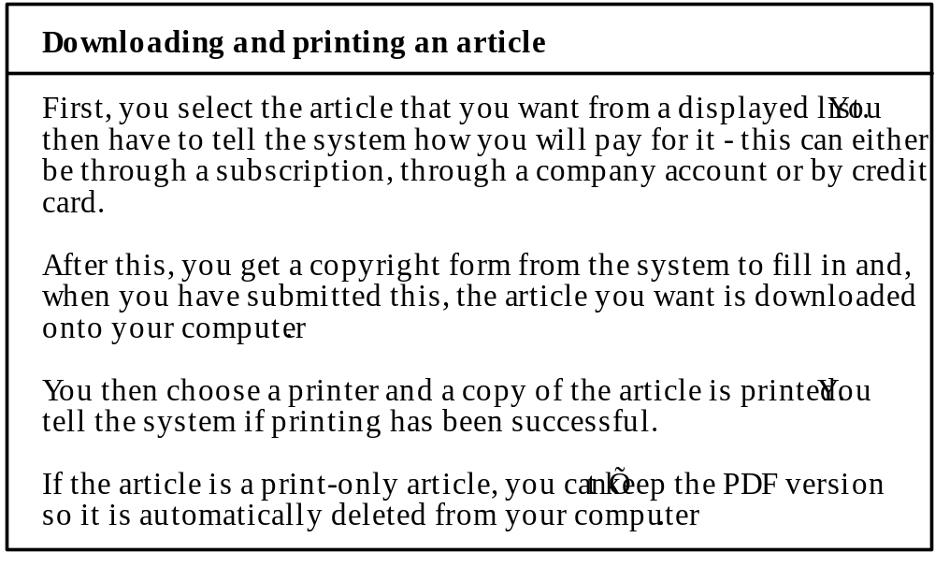
Story card for document downloading

Slide 21
XP and change
Conventional wisdom in software engineering is to design for change. It is worth spending time and effort anticipating changes as this reduces costs later in the life cycle.
XP, however, maintains that this is not worthwhile as changes cannot be reliably anticipated.
Rather, it proposes constant code improvement (refactoring) to make changes easier when they have to be implemented.

Slide 22
Testing in XP
Test-first development.
Incremental test development from scenarios.
User involvement in test development and validation.
Automated test harnesses are used to run all component tests each time that a new release is built.

Slide 23
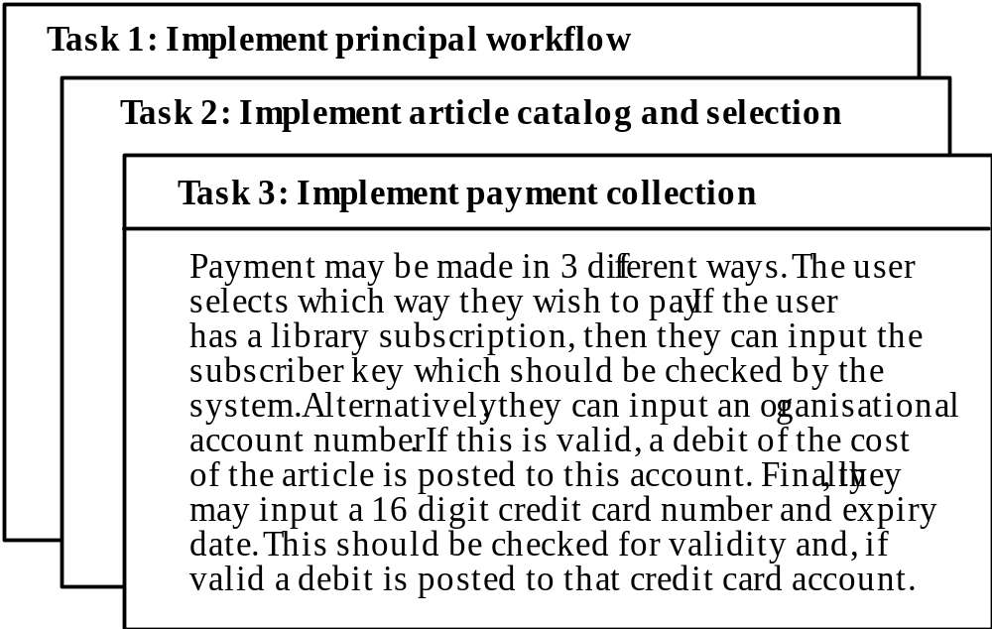
Task cards for document downloading

Slide 24
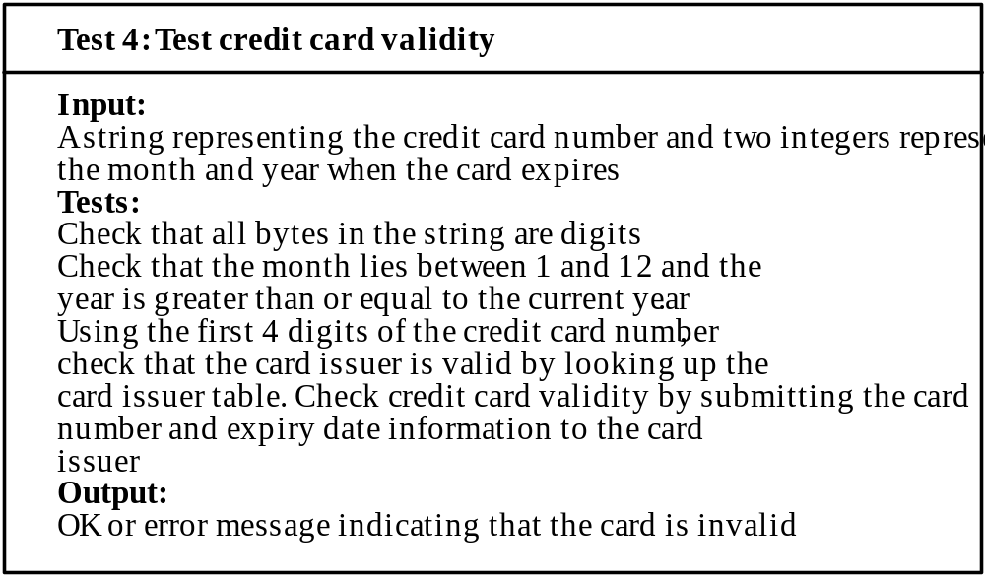
Test case description

Slide 25
Test-first development
Writing tests before code clarifies the requirements to be implemented.
Tests are written as programs rather than data so that they can be executed automatically. The test includes a check that it has executed correctly.
All previous and new tests are automatically run when new functionality is added. Thus checking that the new functionality has not introduced errors.

Slide 26
Pair programming
In XP, programmers work in pairs, sitting together to develop code.
This helps develop common ownership of code and spreads knowledge across the team.
It serves as an informal review process as each line of code is looked at by more than 1 person.
It encourages refactoring as the whole team can benefit from this.
Measurements suggest that development productivity with pair programming is similar to that of two people working independently.

Slide 27
Rapid application development Techniques
Before Agile thinking, RAD techniques have been developed for many years.
RAD techniques evolved from so-called 4GL in the 1980s.
These are designed to develop data-intensive business applications and rely on programming and presenting information from a database.
Notes:
4GL, non-procedural, problem oriented, reduce programming effort, cost, etc.

Slide 28
RAD environment tools
Database programming language
Interface generator
Links to office applications
Report generators

Slide 29
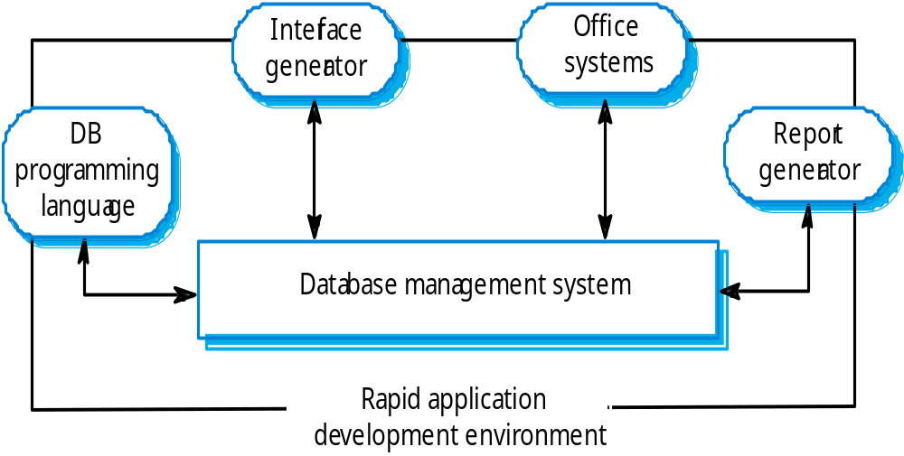
A RAD environment

Slide 30
Interface generation
Many applications are based around complex forms and developing these forms manually is a time-consuming activity.
RAD environments include support for screen generation including:
  Interactive form definition using drag and drop techniques;
  Form linking where the sequence of forms to be presented is specified;
  Form verification where allowed ranges in form fields is defined.

Slide 31
Visual programming
Scripting languages such as Visual Basic support visual programming where the prototype is developed by creating a user interface from standard items and associating components with these items
A large library of components exists to support this type of development

Slide 32
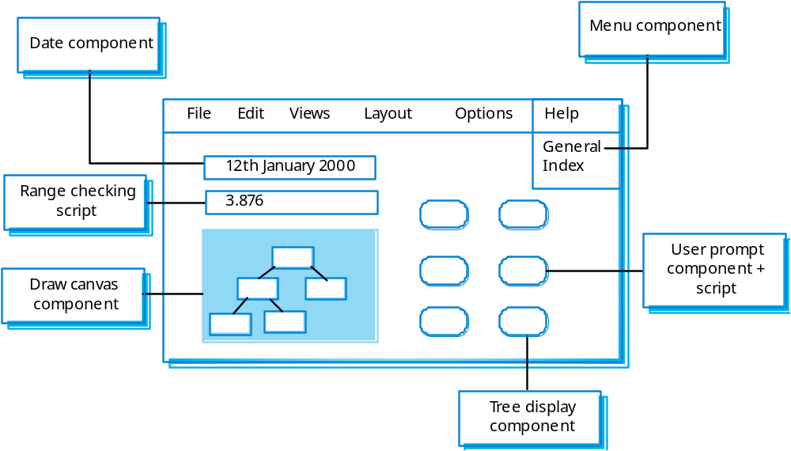
Visual programming with reuse
z

Slide 33
Problems with visual development
Difficult to coordinate team-based development.
No explicit system architecture.
Complex dependencies between parts of the program can cause maintainability problems.

Slide 34
COTS reuse
An effective approach to rapid development is to configure and link existing off the shelf systems.
For example, a requirements management system could be built by using:
  A database to store requirements;
  A word processor to capture requirements and format reports;
  A spreadsheet for traceability management;

Slide 35
Compound documents
For some applications, a prototype can be created by developing a compound document.
This is a document with active elements (such as a spreadsheet) that allow user computations.
Each active element has an associated application which is invoked when that element is selected.
The document itself is the integrator for the different applications.

Slide 36
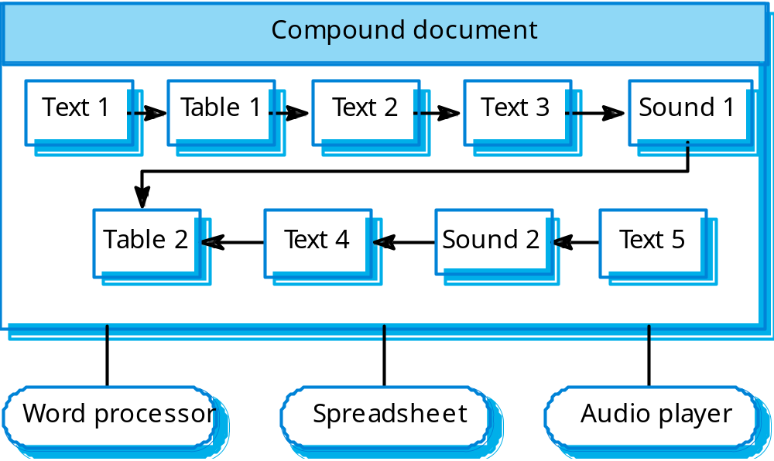
Application linking

Slide 37
Software prototyping
A prototype is an initial version of a system used to demonstrate concepts and try out design options.
A prototype can be used in:
  The requirements engineering process to help with requirements elicitation and validation;
  In design processes to explore options and develop a UI design;
  In the testing process to run back-to-back tests.

Slide 38
Benefits of prototyping
Improved system usability.
A closer match to users’ real needs.
Improved design quality.
Improved maintainability.
Reduced development effort.

Slide 39
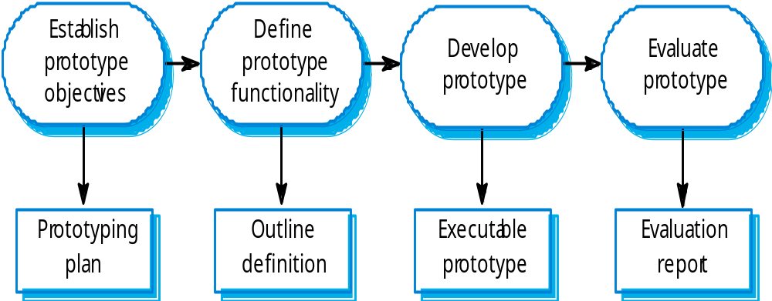
The prototyping process

Slide 40
Throw-away prototypes
Prototypes should be discarded after development as they are not a good basis for a production system:
  It may be impossible to tune the system to meet non-functional requirements;
  Prototypes are normally undocumented;
  The prototype structure is usually degraded through rapid change;
  The prototype probably will not meet normal organisational quality standards.

Slide 41
Key points
An iterative approach to software development leads to faster delivery of software.
Agile methods are iterative development methods that aim to reduce development overhead and so produce software faster.
Extreme programming includes practices such as systematic testing, continuous improvement and customer involvement.
The approach to testing in XP is a particular strength where executable tests are developed before the code is written.

Slide 42
Key points
Rapid application development environments include database programming languages, form generation tools and links to office applications.
A throw-away prototype is used to explore requirements and design options.
When implementing a throw-away prototype, start with the requirements you least understand; in incremental development, start with the best-understood requirements.

